Slide 1
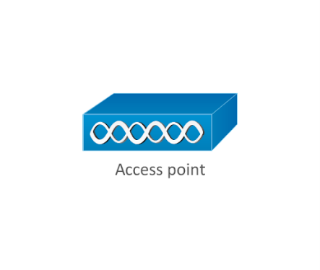



RADIUS
Authentication
Server
Supplicant
Authenticator
802.11i
WPA2
Enterprise
802.1X
Port-Based Authentication
EAP
PEAP
EAP-TLS
EAP-TTLS
EAP-FAST
RADIUS (1812/1813)
UDP
Unencrypted
Users
AAA at the RADIUS
server

Slide 2

TACACS+ with Kerberos
Authentication
Server
Principal
TACACS
XTACACS
TACACS+ (49)
AS
KDC
TGS
Kerberos (88)
Authentication
TCP
Developed by
Cisco (Employed
on routers)
TCP
Encrypted
Users/devices
Authorization/Accounting
at the Kerberos server

